Slide 1
2011 AP Chemistry Exam Review
Adapted from: Todd Abronowitz

Slide 2
2015 AP Chemistry Exam Format
Section I: 60 Multiple-Choice Questions
(90 minutes, 50% of final grade)
- no calculator
Section II: Seven Free-Response Questions (105 minutes, 50% of final grade) -3 long-answer questions -4 short-answer questions

Slide 3
Free-Response Skills Assessed
Experimental design
Quantitative/qualitative translation
Analysis of authentic lab data and observations to identify patterns or explain phenomena
Creating or analyzing atomic and molecular views to explain observations
Following a logical/analytical pathway to solve a problem

Slide 4
The 2011 STATS
Number of students: 122,651
Number receiving a qualifying score: 67,418 (55.0%)
Score of 5: 17.0%
Score of 4: 18.4%
Score of 3: 19.5%
Score of 2: 14.6%
Score of 1: 30.4%

Slide 5
Internally Consistent
When grading the AP Chemistry exam….the concept of “internally consistent” is used. If you need the answer from part (a) of a problem in part (b) and you made a mistake in part (a) you can still receive full credit for part (b) if all work is shown and the work is correct.

Slide 6
Internally Consistent
Common places for “IC” on the test:
Lewis Dot Diagram questions
Rate Law problems
Students making math mistakes

Slide 7
Entry Point
The questions are designed to have an “entry point” for the student.
An entry point is a relatively easy question (usually worth one point).
It is designed to give the students a feeling of “I can do this problem”
Build confidence in the student so they attempt to do the problem.

Slide 8
Question One

Slide 10
Entry Point for this question. (1 point)
Sometimes the second stem also has an entry point. (1 point)
Note: This is the most common entry point for equilibrium problems.

Slide 11
Two most common entry points on equilibrium questions
Write the equilibrium expression.
Write the ionization equation.

Slide 12
Chief Reader Comments
Students did reasonably well on this question, earning a mean score of 3.65 out of a possible 10 points and showing a broad distribution, with many students earning 4 or 5 points.
Approximately 12 percent of students failed to address the question or earned no points, while 1.4 percent earned full credit.

Slide 13
Grade Distribution Question 1

Slide 14
Chief Reader Comments
Most frequently, students earned all their points early in the question, and it was comparatively rare that a response would fail to earn points on a given part and then earn points on subsequent parts of the question.

Slide 15
Chief Reader Comments
The large percentage of scores of 4 typically earned all 4 points on parts (a), (b)(i) and (b)(ii) and failed to earn points on subsequent parts of the question. Those responses that earned 5 points usually earned them all on parts (a), (b) and (c)(i).
Look at the entry points and you can see why the score distribution favors 4 & 5 points.

Slide 16
Chief Reader Comments
Based on your experience of student responses at the AP Reading, what message would you like to send to teachers that might help them to improve the performance of their students on the exam?
• Distinguish between amount (moles) and concentration (molarity = mol/L). Reinforce notation that “[ ]” refers to the molar concentration of a species.
• Demonstrate or provide a laboratory exercise to familiarize students with the pH scale.
• Emphasize the distinction between an equilibrium constant expression and its value.

Slide 17
Chief Reader Comments
Based on your experience of student responses at the AP Reading, what message would you like to send to teachers that might help them to improve the performance of their students on the exam?
• Practice identifying buffers — have students make up buffers in different pH ranges.
• Demonstrate that a buffer can be treated as a weak acid in equilibrium with its conjugate base OR as a weak base in equilibrium with its conjugate acid, and that the approaches are equivalent.
• Require clear work shown on calculated answers — stress process rather than memorization of formulas (IC showing up here).

Slide 18
Chief Reader Comments
Suggestions for students:
• Read and answer the questions that are asked.
• Be sure that numerical answers are reasonable.
• Differentiate between moles and concentration (moles/liter).
• Practice writing clear, expository statements regarding chemical systems.
• Use vocabulary correctly.

Slide 19
Question Two

Slide 20
Science Practices
AP science revisions focus on seven overarching practices that capture important aspects of the work of scientists. Science practices describe the knowledge and skills students should demonstrate to reach a goal or complete a learning activity.

Slide 21
Science Practices
They must be taught explicitly and applied reflectively and critically. We encourage teachers to keep science practices in mind when planning instruction.
(http://advancesinap.collegeboard.org/science/practice)

Slide 22
Science Practice 1
The student can use representations and models to communicate scientific phenomena and solve scientific problems.
Science Practice 2
The student can use mathematics appropriately.

Slide 23
Science Practice 3
The student can engage in scientific questioning to extend thinking or to guide investigations within the context of the AP course.

Slide 24
Science Practice 4
The student can plan and implement data collection strategies in relation to a particular scientific question. (Note: Data can be collected from many different sources, e.g., investigations, scientific observations, the findings of others, historic reconstruction and/or archived data.)
Science Practice 5
The student can perform data analysis and evaluation of evidence.

Slide 25
Science Practice 6
The student can work with scientific explanations and theories.
Science Practice 7
The student is able to connect and relate knowledge across various scales, concepts and representations in and across domains.

Slide 26
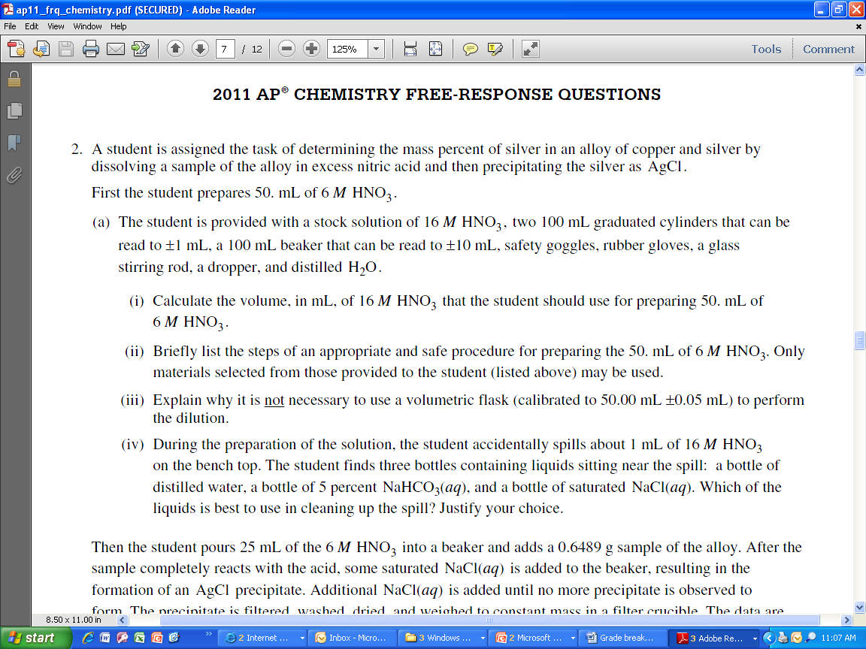

Slide 27
Entry Point for this question. (1 point)

Slide 28
S.P. 3 & 4
S.P. 3 & 4
S.P. 2
S.P. 3 & 4
S.P. 3, 4 & 5
S.P. 3 & 7
Please note: The S. P. are NOT assigned by the College Board.

Slide 29
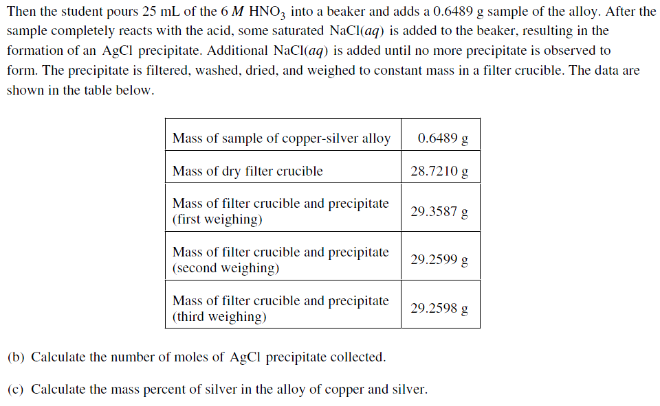
S.P. 3 & 4
S.P. 1
S.P. 2 & 5
S.P. 2 & 5

Slide 30
Note on Sig Figs
Significant figures are generally being addressed in the lab based question.
Questions 1 and 3 did not address significant figures at all.

Slide 31
Note on Sig Figs
Only in part B were sig figs looked at. The sig figs also had to be perfect. There was not a +/-1 significant figure grace (when students are asked to do data analysis in the laboratory based question, there is no longer any grace on the sig figs – it must be PERFECT!!!).

Slide 32
Chief Reader’s Comments on Sig Figs and molar mass
Since students were manipulating experimental data, they were held stringently to the proper number of significant figures. Many students did not use the molar masses (or all of the significant figures in the molar masses) provided to them in the periodic table (143 g/mol was common).

Slide 33
Note on Sig Figs
Because the 6 M solution was not written as 6.0 M, the significant figures were not addressed. The students were to recognize that the concentration of HNO₃ is not critical (WHY) - therefore sig figs not necessary.
Also allows another answer to receive full credit for part (a) (iii). What is it?

Slide 34
Chief Reader Comments
The mean score was 3.51 out of a possible 9 points. Approximately 26 percent of students earned a score of 3 or 4, 14 percent earned no points or did not address the question, and only 1 percent earned the maximum score.

Slide 35
Grade Distribution Question 2

Slide 36
Chief Reader Comments
Students generally answered all parts of the question, with most of the points being earned in part (a)(i) for correctly calculating the volume of concentrated HNO₃ needed to prepare 50 mL of a 6 M HNO₃ solution and in part (c) for recognizing that the mass percent of Ag in the alloy was based on the mass of the alloy.

Slide 37
Chief Reader Comments
Students had a difficult time expressing themselves in parts (a)(ii) through (a)(iv) and determining the correct mass for the dried AgCl precipitate in part (b).

Slide 38
Chief Reader Comments
Part a (ii) Briefly list the steps of an appropriate and safe procedure for preparing the 50. mL of 6 M HNO₃. Only materials selected from those provided to the student (listed above) may be used.
ANSWER: Wear safety goggles and rubber gloves. Then measure 19 mL of 16M HNO₃ using a 100 mL graduated cylinder. Measure 31 mL of distilled H₂O using a 100 mL graduated cylinder. Transfer the water to a 100 mL beaker. Add the acid to the water with stirring.
1 point is earned for properly measuring the volume of 16M HNO₃ and preparing a 6 M HNO₃ acid solution.
1 point is earned for wearing protective gear and for adding acid to water.
CRC: The second point students could earn was based on addressing the safety precautions needed to carry out the dilution. Most students listed “put on safety goggles and rubber gloves” on the first line of their response but often incorrectly “poured water into acid.” A variation of this error occurred when students neglected to specify the order of mixing, such as “pour the acid and water into the beaker for mixing.”

Slide 39
Question Three

Slide 40
Question Three – First part

Slide 41
Question Three – First part
Entry Point for this question. (1 point)

Slide 42
Question Three – Second part

Slide 43
Question Three – Second part
Entry Point for this question. (1 point)
Entry Point for this question. (1 point)

Slide 44
Question Three – Second part
Science Practice 7
The student is able to connect and relate knowledge across various scales, concepts and representations in and across domains.

Slide 45
Chief Reader Comments
The mean score was 3.18 out of a possible 10 points.
The most common score was zero.

Slide 46
Grade Distribution Question 3

Slide 47
Chief Reader Comments
Part (a) was the most accessible part of the question. The point was lost for mechanics (off by a factor of two, wrong sign, or no units) more than for conceptual misunderstandings.

Slide 48
Chief Reader Comments
For Students
• Show your work explicitly on all calculation problems.
• Remember that units of quantities are important and may be manipulated algebraically throughout a calculation.

Slide 49
Chief Reader Comments
For Students
• On calculator questions a numerical answer is required; showing a setup is not sufficient. (Ask me why this is here)
• Use the lined space allowed for answers instead of cramping a few numbers between the lines of a question.

Slide 50
Question Four

Slide 51
Chief Reader Comments
The mean score was 6.62 out of a possible 15 points. Students displayed a wide range of knowledge and skills in their responses to this question. The scores covered the entire scale and had a relatively normal distribution.

Slide 52
Give students practice balancing equations not only for mass, but also for charge. A routine of checking for the balance of both should be established.
• Offer students practice writing chemical formulas for molecules, atoms and ions in solution. Stress that all soluble ionic compounds should be dissociated and any of the six strong acids should be ionized. All other species, such as elements or covalent (molecular) compounds, should not be written as ions.

Slide 53
Remind students that neutralization reactions and coordination complex formation reactions do not involve oxidation or reduction of any species.
• Expose students to some coordination chemistry. They need to recognize common ligands and practice writing acceptable coordination compounds with appropriate charges.
• Encourage students to use the table of reduction potentials provided to help them write a correct redox reaction.

Slide 54
• Remind students that the answer box should contain only the final, balanced chemical equation. Emphasize that the box should not contain oxidation numbers, scratch work, any other extraneous charges or numbers, or extra equations.

Slide 55
Grade Distribution Question 4

Slide 56
Question Five

Slide 58
Entry Point for this question. (1 point)
Secondary Entry Point for this question. (1 point)
Internally consistent – based on part (a)

Slide 60
Entry Point for this question. (1 point)
Secondary Entry Point for this question. (1 point)

Slide 61
Chief Reader Comments
The mean score was 3.04 out of a possible 8 points. Students generally attempted all parts of the question, with most of the points earned in part (a) by completing the Lewis diagram, in part (b) by identifying the arrangement of atoms or by citing electron-pair repulsion, in part (e) by identifying and justifying an oxidation-reduction reaction, and in part (f) by assigning an appropriate sign to entropy with a valid justification.

Slide 62
Grade Distribution Question 5

Slide 63
Question Six

Slide 65
Entry Point for this question. (1 point)

Slide 67
Entry Point for this section –if you teach graphical kinetics. (4 point)

Slide 68
Chief Reader Comments
The mean score was 2.98 out of a possible 8 points. Students generally attempted all parts of the question. If parts were omitted it was generally part (a) or part (c)(iii). Many students earned just 1 point in part (b). Of the points missed, they commonly were missed in all parts of (c). Approximately 13 percent of students either earned no points with their response or failed to address the question, while 2 percent achieved a score of 8.

Slide 69
Grade Distribution Question 6

Slide 70
Chief Reader Comments
Common themes throughout the test

Slide 71
CRC: Common to all questions
It is impossible to overemphasize the importance of writing precisely. Vague and unclear answers often made it impossible for AP Readers to determine whether the student understood the chemistry. Clear, precise, and succinct prose does not come naturally; we all must work on this and hold our students accountable for use of correct terminology.

Slide 72
CRC: Common to all questions
When justifying answers, statements of fact are not enough; an explanation of “why” must be provided.
Teach students to set up the problem, substitute the numbers in, and then do the calculation. Often in a non-calculator problem, if the work was clearly shown, a point would be earned even when a computational error was made.

Slide 73
For the students
• DO NOT write your answers in the body of the question; write them on the lined pages.
• Skip a line between subsections for clarity and ease of evaluation
• Your written, nonmathematical, answers should be neat and concise responses.
Remember, AP Readers can best grade your exam if you write clearly and use proper grammar. Write in pencil or blue-ink pens and avoid using pens that smear easily.
Use the lined space allowed for answers instead of cramping a few numbers between the lines of a question.

Slide 74
For the students
• Familiarize yourself with the resources provided to you in the exam booklet.
Read and answer the questions that are asked.
If you are asked to select the best answer, make a single selection and justify the reasoning for making that choice.
• If you are asked to make a comparison, mention both possibilities and then make a single choice with accompanying justification.

Slide 75
Calculator Based Questions
• Show your work explicitly on all calculation problems.
• Be sure that numerical answers are reasonable.
• Remember that units of quantities are important and may be manipulated algebraically throughout a calculation.
• On calculator questions a numerical answer is required; showing a setup is not sufficient.
• Be cognizant of significant figure rules and how to apply them correctly.

Slide 76
What Else?????

