Slide 1
AP Free Response Question Analysis
Equilibrium

Slide 2
Typical Scores
Year | Mean Score | Out of | Percentage
2003 | 3.35 | 10 | 33.5%
2004 | 4.7 | 10 | 47.0%
2005 | 5.58 | 10 | 55.8%
2008 | 4.17 | 9 | 46.3%

Slide 3
Chief Reader’s Comments
2006: “Students did a good job answering the question, earning a mean score of 4.19 out of a possible 9 points.” (46.6%)
2007: “Students did a good job answering this question, earning a mean score of 4.48 out of a possible 9 points.” (49.8%)

Slide 4
Chief Reader’s Comments
2009: “Students preformed well on this question. The mean score was 4.46 out of 10 possible points.” (46.6%)
2010: “Overall students did reasonable well when answering this question. The mean score was 3.66 out of 10 possible points.” (36.6%)

Slide 5
Chief Reader’s Comments
2011: “Students did reasonably well on this question, earning a mean score of 3.65 out of a possible 10 points. Approximately 12 percent of students failed to address the question or earned no points, while 1.4 percent earned full credit.” (36.5%)

Slide 6
What does this tell us?
If you can get half the points….you did REALLY WELL!!!!
Questions are hard.
Attempt to do ALL parts of the problems.

Slide 7
The general instructions: Notice the reference to partial credit. You MUST show your work.
Notice the point breakdown. This question is 20 percent of the free response grade. The FR is 50% of the overall grade…so this question is 10% of your grade.
Significant Figures

Slide 8
The first stem in the problem.
Subparts to the first stem.
The second stem in the problem.
Followed by three subparts.

Slide 9
2001 to 2011 AP FR Question
22 total AP questions
141 total subparts to the questions
Average of 6.4 subparts per question

Slide 10
Calculations
86 subparts of those were calculations
61% of the subparts
The word “calculate” appeared 64 times
An average of almost 3 times per question
45% of the subparts had this word.

Slide 11
Only two types of Equilibrium
You are given Keq
Asked to find Keq
12 times
Means that you will have an “X” in the RICE table and you will find the “X”.
Fill out the RICE table completely.
Often the RICE table once filled-in will provide you some points.
13 times
Means that you will have all values to fill in the RICE table.
Often this is done by providing you with pH or percent ionization (if aqueous) or dissociation (if a gas).

Slide 12
Usually the Keq value is given to the right of the equation.
The equations are always centered and will be balanced.

Slide 13
As soon as you see the value for Keq is provided to you, you know several things:
RICE table will have an “X” in it.
Will be looking for a value from the RICE table.
Will be using the equation provided as the “R” part in RICE table.
May answer more than one subpart by filling out the RICE table.
Remember you can do the question in any order that you want.

Slide 14
Entry Point
The questions are designed to have an “entry point” for the student.
An entry point is a relatively easy question (usually worth one point).
It is designed to give the students a feeling of “I can do this problem”
Build confidence in the student so they attempt to do the problem.

Slide 15
Write the Equilibrium Expression
17 times
(This is the most common entry point in these questions)

Slide 16
Entry Point for this question.
Sometimes the second stem also has an entry point. This one does not.

Slide 17
Support yourself 21% of the time
“Justify your answer“
Others
Appeared 22 times on the subparts (15.6 percent of them)
Support your answer with a calculation: 4
“Explain your answer”: 2
“Account for this __”: 2

Slide 18
Calculate
Calculate
Calculate
Calculate

Slide 19
Calculate = you must have some type of math calculations to support your answer.

Slide 20
SHOW YOUR WORK SHOW ALL OF YOUR WORK SHOW MORE OF YOUR WORK!!

Slide 21
Internally consistence
Every question on the Free-response part of the test will be graded on an “internally consistence” basis.
That means that if you make a math mistake and show your work, you can still get credit for your answers if the work is consistence with your mistake.

Slide 22
Internally consistence
If you need the answer from subpart (a) to do subpart (b) and you make a mistake in (a) but use that answer correctly to get the answer for subpart (b), you can still get fill credit on subpart (b).

Slide 23
2011 Form B

Slide 24
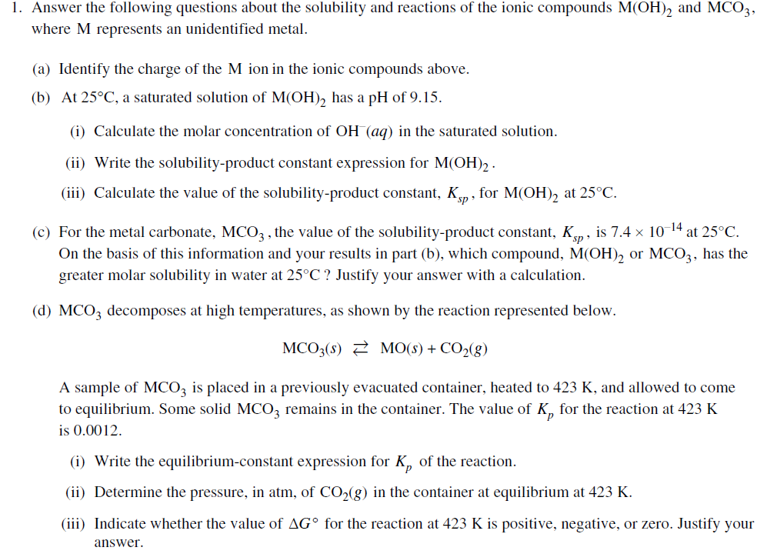
Entry point for problem

Slide 25
Entry point for first stem.

Slide 26
Entry point for second stem.

Slide 27
Calculate K_{sp} ➔ all numbers in the RICE table

Slide 28
Make sure you answer the question…circle this as you read the problem

Slide 29
Given Ksp value ➔ “X” in RICE table

Slide 30
Make sure you answer the question…circle this as you read the problem

Slide 31
Make sure you answer the question…circle this as you read the problem

Slide 32
Scoring Standards

Slide 33
Notice multiple points earned in this question.

Slide 34
Notice the ICE table. You must set it up.

Slide 35
Notice that how easy it is to get the first point (comes straight from the ICE table). The K_{eq} value must be consistent with the answers for the concentrations.

Slide 36
You get the values from the RICE table. Fill it in correctly, and bingo…points!!!

Slide 37
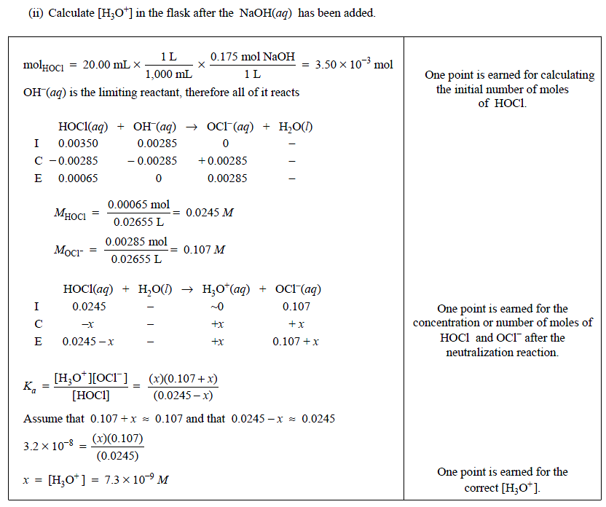
Notice the ICE tables.
If they are on the scoring guidelines, they want to see them on your paper.

Slide 38
Chief Readers Comments
The Chief Reader oversees the grading of the AP exam and determines the raw scores needed to earn a score of one, two, three, four or five

Slide 39
Comments of CR to this question
Based on your experience at the AP Reading, what message would you like to send to teachers that could improve the performance of their students on the exam?

Slide 40
Continue to emphasize that an answer should be supported with work, use of units, and use of significant figures (especially significant figures in logs).
Continue to emphasize that an answer should be supported with work and use of units.

Slide 41
Stress the interpretation of numerical data and “reasonable” values. Students should be able to estimate order-of-magnitude values for quantities without performing calculations and should be able to recognize chemically absurd values.

Slide 42
Encourage students to add comments in a response when a numerical result appears to be incorrect. This may give readers a reason to look again for partial credit points. For example, “This pH value (14.6) must be wrong, since pH is unlikely to be highly basic for this reaction!”

Slide 43
Emphasize to students that it is to their benefit to write clearly.
Discourage students from the use of ambiguous pronouns; often Readers cannot identify the referent of the pronoun “it”. Emphasize that points are earned only when Readers can clearly understand what is written down.

Slide 44
Provide practice in writing justifications. Emphasize that one-word answers are not considered justifications. Many times a correct relationship did not earn points because the justification was missing.
Teachers should stress to their students that they should read all of the parts of a question thoroughly and answer the questions as it was written.

Slide 45
Emphasize that equilibrium expressions do not include solids, and that these expressions need to include charges on ions.

Slide 46
Use the “ICE” table set-up for equilibrium systems. An ICE table specifies the initial, change, and equilibrium conditions and, when completed correctly, provides student with all of the information required to successfully solve any equilibrium problem.

Slide 47
Suggestions for students:
Show all work for calculations to receive credit
Remember that small capital letters are not acceptable for the second letter in a chemical symbol (e.g. BR instead of Br).
Set up problems clearly; circle answers
Continue to practice proper algebraic methods (e.g. [2x]² ≠ 2x²).

